Slide 1
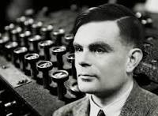
THE ENIGMA

Slide 2
General information
On September 4, 1939, the day after the outbreak of British war against Germany, Alan Turing left Cambridge University and presented himself at Bletchley Park. North London, to participate in the UK's most secretive programme. The purpose of the programme was to break the code of conduct of the German armed forces, an encryption-communications system that was considered impossible to break.

Slide 3
What was the Enigma machine?
The 'Enigma' machine was designed by German engineer Artur Surbius at the end of WWII in response to the continuous decoding of German codes during the war and adopted by the German army in 1920.
The first types of machine were simpler and Polish counterintelligence, with the help of theoretical mathematics, managed to break the codes and read the German marks.
But starting in 1938, the Germans began to use more sophisticated machines with more sophisticated encryption systems, and the Polish advantage disappeared

Slide 4
How was it solved?
Turing realized that it was not necessary to examine all possible combinations to break the Enigma machine code. It showed that they could test the correct switch positions without having to look at the dashboard settings. The Turing machine could test combinations of letters at a time that was impossible for any human or group of people to achieve.
Soon the English realized that the Germans were using specific phrases to open and close their messages. They were betrayed by their great confidence. Allied forces did not allow the Germans to understand that they could decrypt their messages. By the end of the war, Bletchley Park scientists had deciphered more than two and a half million messages and had contributed to the victory of the allies.

Slide 5
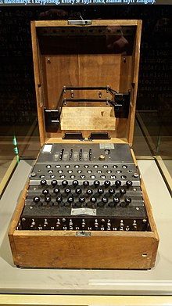
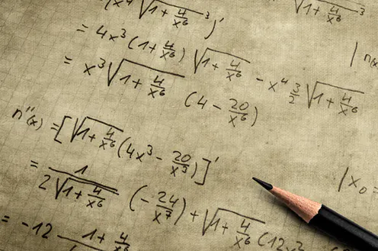
Ultimately, Turing's perseverance and ingenuity would bring success. Turing succeeded in exploiting the errors in both the German encryption process and some of the Enigma part-machine operators, as well as in stealing German codes from captured enemy ships.

Slide 6
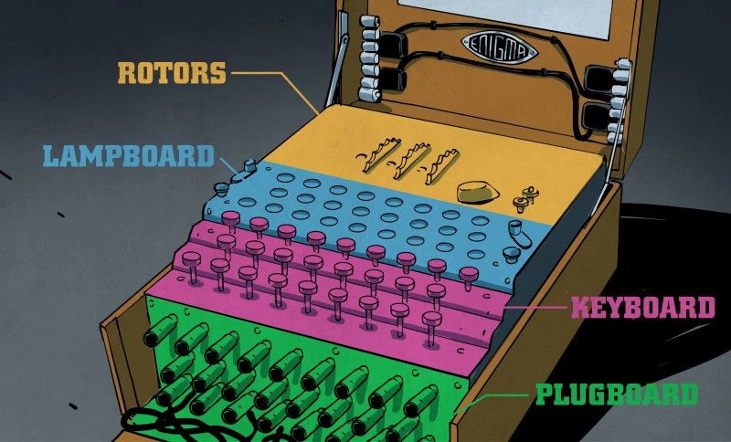
How did the solution of the enigma affect the War?
By the end of the war, 210 cryptanalytic machines would be operational in Britain, reading every single enemy message, except for a 10-month period between February and December 1942 when the German navy activated the Enigma with four rotors.

Slide 7
Movie
We highly recommend you watch this movie which is based on the enigma solution.
https://www.youtube.com/watch?v=nuPZUUED5uk

Slide 8
Sources
https://www.iefimerida.gr/news/54299/%CE%B1%CE%BB%CE%B1%CE%BD
https://www.mixanitouxronou.gr/ayto-itan-to-mystiko-quot-oplo-quot-ton-germanon-poy-kryptografoyse-ta-minymata-ston-v-pagkosmio-polemo-emoiaze-me-grafomichani-pos-quot-espase-quot-to-enigma/
https://el.wikipedia.org/wiki/%CE%91%CE%AF%CE%BD%CE%B9%CE%B3%CE%BC%CE%B1

Slide 9
VASSO SIAKANDARI
ELENI FRAGIADAKI

